Slide 1


Inter-app collusion: Exploiting the improper export of android application components for privilege elevation & credential theft
Actuator.sh
BY EDWARD WARREN

Slide 2
AGENDA
Actuator.sh
_______
#WHOAMI
OVERVIEW OF ANDROID SECURITY CHALLENGES
MECHANISM OF INTER-APP COLLUSION
CASE STUDIES

Slide 3


#whoami
Actuator.sh
Security Analyst at
Any views or opinions expressed are solely my own.
I

Slide 4

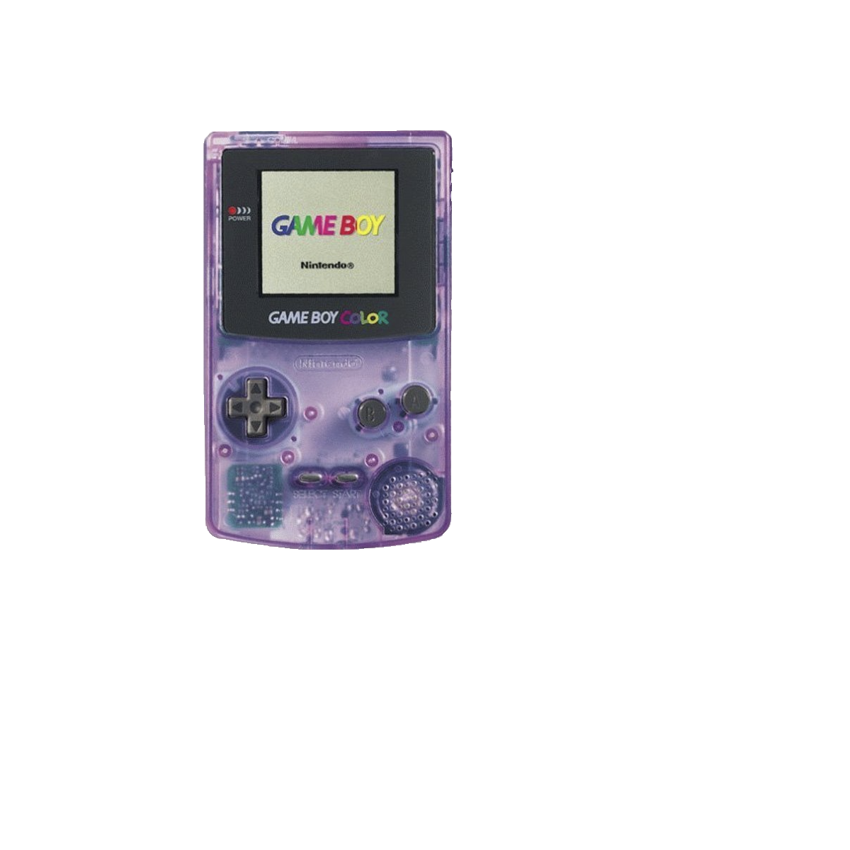
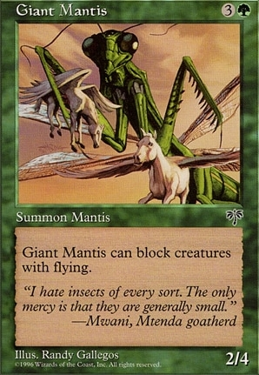

#whoami
Bug Enthusiast =)
Actuator.sh

Slide 5




A Brief Overview of Android application security
Actuator.sh

Slide 6
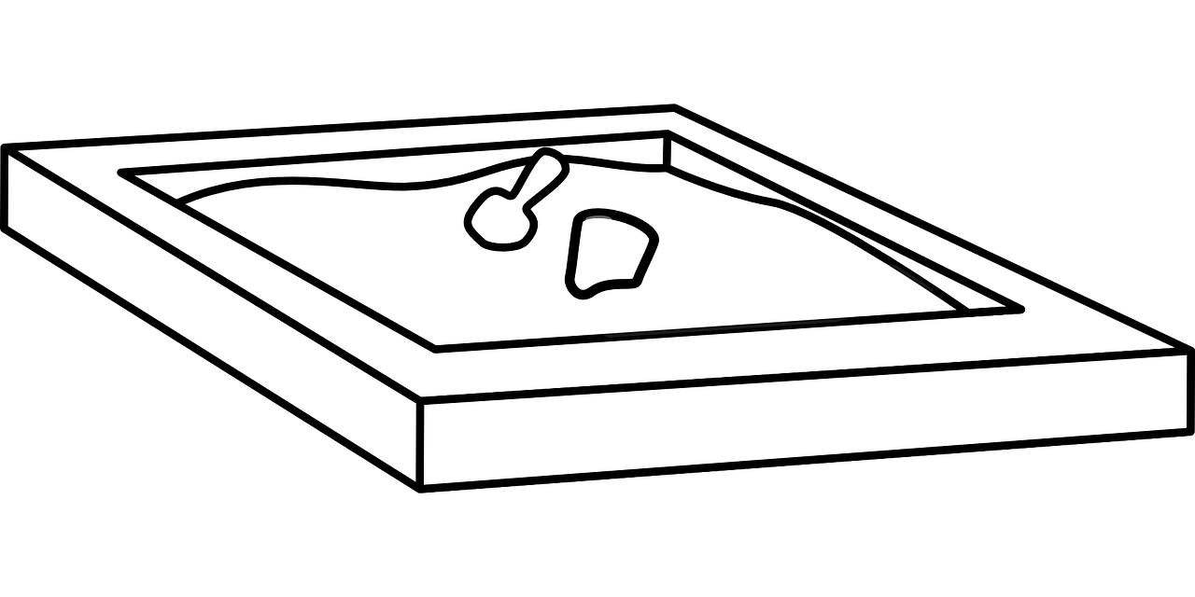
The Android Sandbox
Actuator.sh
Android's Foundation
– Built on the Linux Kernel & tailored for mobile devices.
Security Focus
– Critical in mobile computing due to personal data sensitivity.
Sandbox Concept
– Isolates application processes for enhanced security.

Slide 7
The Android Sandbox
Actuator.sh
____
Unique User IDs (UIDs)
– Each app assigned a distinct UID at install time.
Process Isolation
– Apps run in isolated processes, limiting interaction and data access.
Permission System
– Access to resources like Phone, Internet, Camera, Contacts & Location requires user consent.
Inter-Process Communication (IPC)
– Controlled and secure communication channels between apps.

Slide 8





Mechanism of Inter-App Collusion
Actuator.sh
Inter-Process Communication (IPC)

Slide 9
Mechanism of Inter-App Collusion
Actuator.sh
Inter-Process Communication (IPC)
INTENT

Slide 10

Mechanism of Inter-App Collusion
Actuator.sh
Inter-Process Communication (IPC)
INTENT
BINDER

Slide 11
Mechanism of Inter-App Collusion
Actuator.sh
INTENT

Slide 12

Mechanism of Inter-App Collusion
Actuator.sh
INTENT
INTENT
FILTER

Slide 13

Mechanism of Inter-App Collusion
Actuator.sh
INTENT
ANDROID
MANIFEST

Slide 14
The Android Sandbox
Actuator.sh
____ Permission Types:
Normal
Dangerous

Slide 15
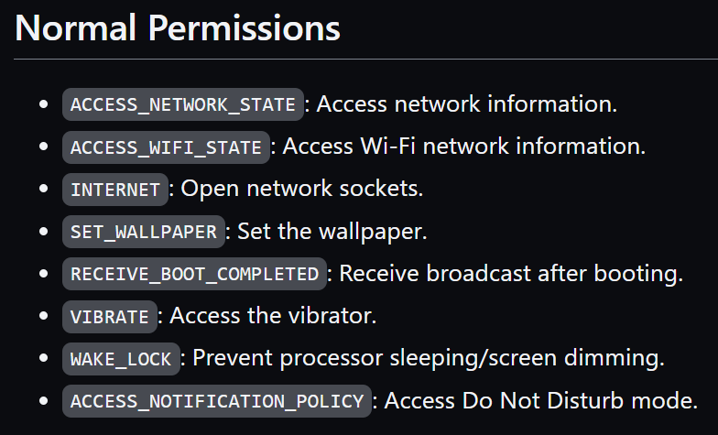
Normal Permissions
Actuator.sh
____

Slide 16
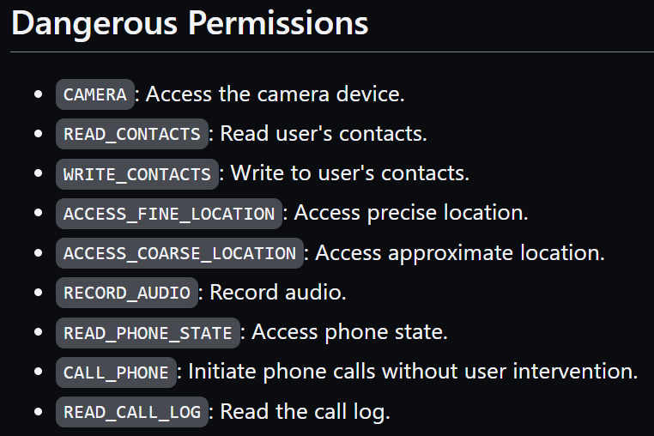
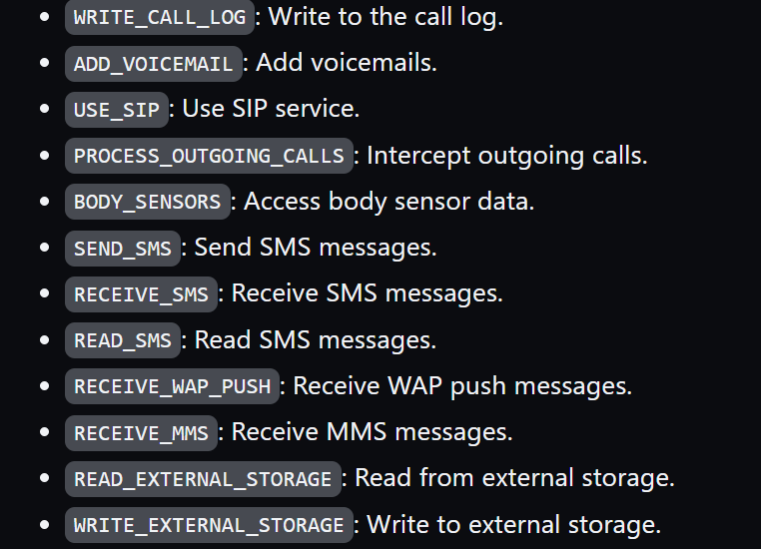
Dangerous Permissions
Actuator.sh
____

Slide 17
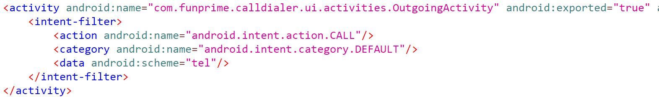

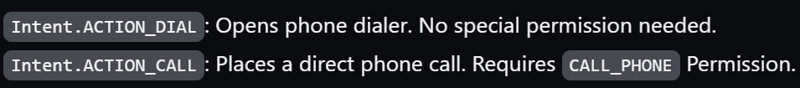
Mechanism of Inter-App Collusion
Actuator.sh
Android Manifest

Slide 18

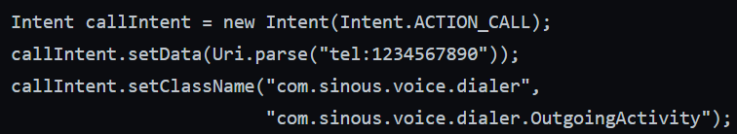
Mechanism of Inter-App Collusion
Actuator.sh

Slide 19

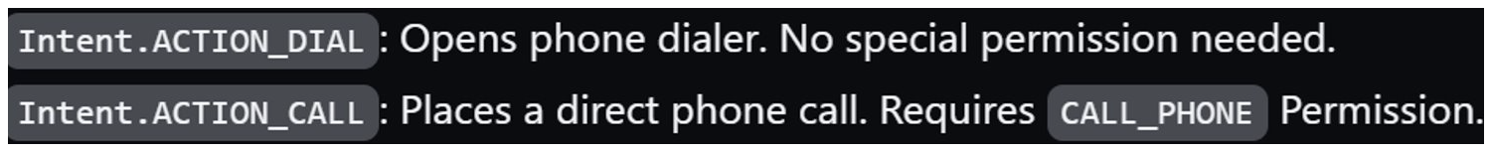
Mechanism of Inter-App Collusion
Actuator.sh

Slide 20

Mechanism of Inter-App Collusion
Actuator.sh

Slide 21
Mechanism of Inter-App Collusion
Actuator.sh

Slide 22
Mechanism of Inter-App Collusion
Actuator.sh
RUNTIME PERMISSION CHECK

Slide 23

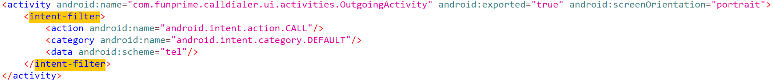
Mechanism of Inter-App Collusion
Actuator.sh

Slide 24
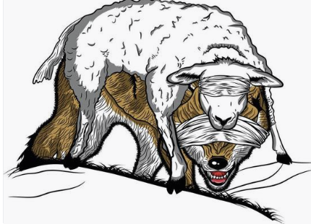
Threat Model
Actuator.sh
h
A malicious installed application with no permissions can leverage adjacent applications to achieve Elevation of Privileges via insecure intent handling the exported activity endpoint.

Slide 25
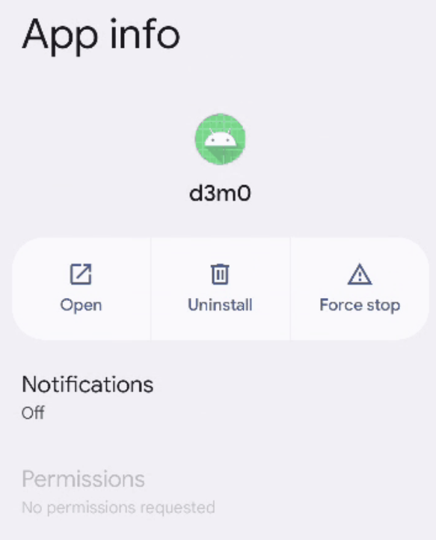


Threat Model
Actuator.sh
h

Slide 26
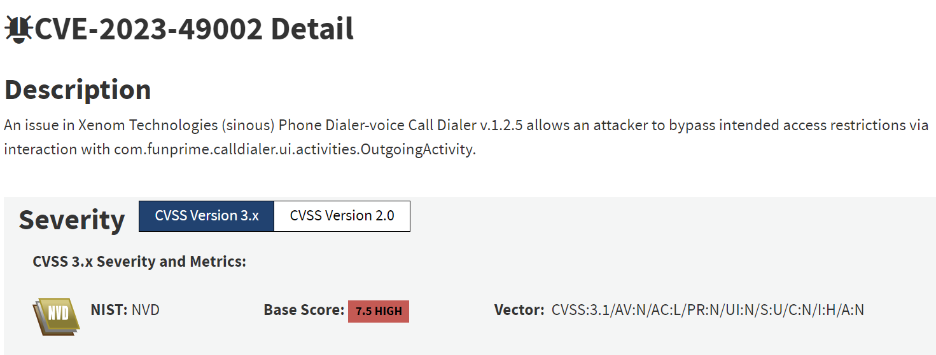
CVE-2023-49002 | CVSS 7.5
Actuator.sh
Case Study #1
M mmmmmmm6676665rrr

Slide 27

CVE-2023-49002 | CVSS 7.5
Actuator.sh
Case Study #1
'com.sinous.voice.dialer'
M mmmmmmm6676665rrr

Slide 28
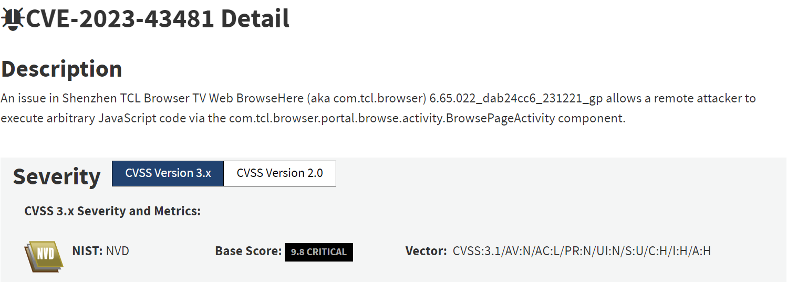
CVE-2023-43481 | CVSS 9.8
Actuator.sh
Case Study #2
M mmmmmmm6676665rrr

Slide 29

Mechanism of Inter-App Collusion
Actuator.sh

Slide 30
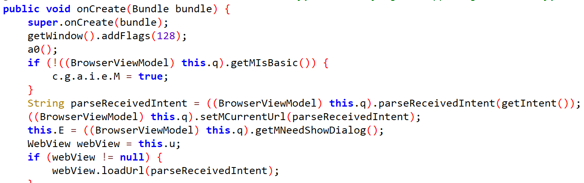
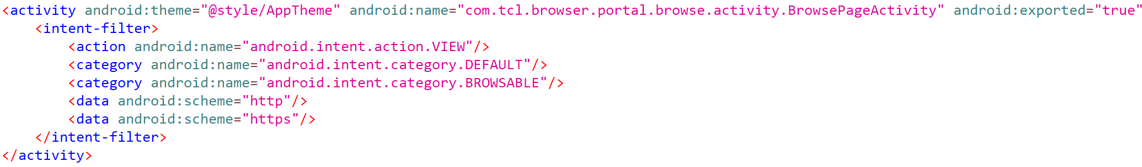
Case Study #2
Actuator.sh
com.tcl.browser.portal.browse.activity.BrowsePageActivity

Slide 31

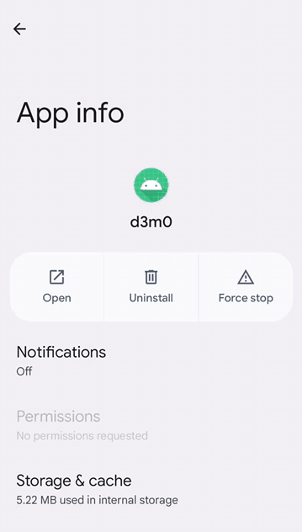
CVE-2023-43481 | CVSS 9.8
Actuator.sh
Case Study #2
'com.tcl.browser'
M mmmmmmm6676665rrr

Slide 32
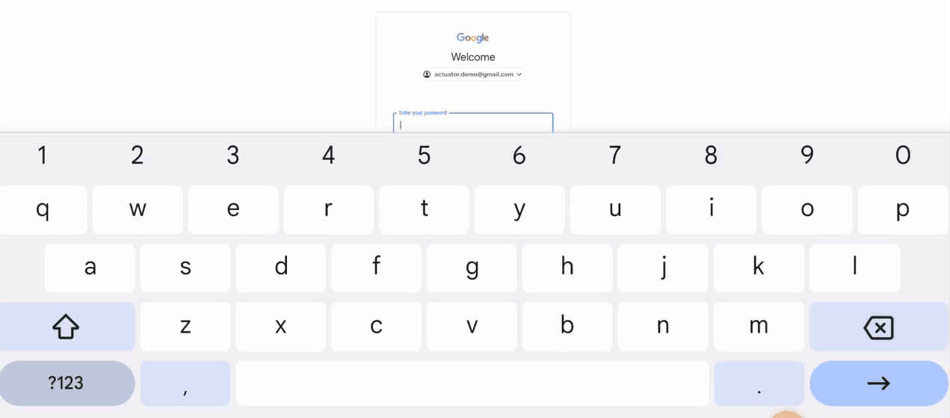
Actuator.sh
M mmmmmmm6676665rrr
Case Study #2
CVE-2023-43481 | CVSS 9.8

Slide 33



Thank You!
Actuator.sh
Socials:
https://github.com/actuator/Shmoocon
https://www.youtube.com/@ACTUATOR
https://infosec.exchange/@actuator
EMAIL:
thanks@actuator.sh
github.com/actuator/shmoocon

